Slide 1


Department of Artificial Intelligence and Data Science
Book Recommendation System
Prasanna K (221801037)
Prasanna S (221801038)
Rohith RA (221801041)

Slide 2
Introduction
The book recommendation software is designed to deliver personalized reading experiences, featuring user-friendly options on the homepage.
Users are guided through a structured selection process, starting with setting their reading preferences, such as time to read constraints and preferred narrative types. The software then provides a dynamic interface for selecting specific genres or themes.
For each chosen preference, the application presents a curated list of recommended books, allowing users to create customized reading lists from an extensive library. The system automatically sorts books by relevance and provides detailed summaries and ratings to enhance the user experience.

Slide 3
Existing Systems
Collaborative Filtering:
-Suggests books based on what similar users have enjoyed
Content-Based Filtering:
-Recommends books that are similar to those a user has liked before
Hybrid Systems:
-Combines collaborative and content-based methods for better recommendations.

Slide 4
Advantages and Disadvantages of Existing System
Limitations of Existing System:
One-Size-Fits-All: Most systems don’t account for individual constraints like available reading time or specific narrative preferences.
Overwhelming Choices: Users can be overwhelmed with options, leading to decision fatigue.
Limited Customization: Many systems do not allow for fine-tuning of recommendations based on multiple, nuanced factors.
Features of Existing System:
Wide Availability:Accessible: Many platforms like Amazon and Goodreads already offer recommendation features, making them easy to access for a large number of users.
Personalized Suggestions:Tailored Choices: Systems like collaborative and content-based filtering provide personalized book suggestions based on user preferences and behavior.

Slide 5
Proposed System
The proposed book recommendation software aims to address the limitations of existing book recommendation systems.
Narrative Style Matching: Matches users with books based on their preferred narrative style, such as character-driven vs. plot-driven, or fast-paced vs. slow burn, for a more personalized reading experience.
Time Commitment Suggestions: Offers book recommendations based on the time users have available to read, suggesting short stories or novellas for shorter time frames and full-length novels or series for longer periods.
Interactive Plot Previews: Provides interactive summaries or key scenes from potential books, allowing users to “try before they buy” by immersing themselves in the story before committing to reading the whole book.
Gamification of Reading Habits: Introduces achievements, badges, and rewards for reading milestones, encouraging users to explore new genres, authors, or reading formats and making the reading experience more engaging.
Book-Movie/TV Show Pairing: Recommends books alongside movies or TV shows that are either adaptations or thematically similar, appealing to users who enjoy cross-media experiences.

Slide 6
Advantages and Disadvantages of Proposed System
Features of Proposed System:
Enhanced Personalization: Matches books to preferred narrative styles.
Optimized Reading Experience: Suggests books based on available reading time.
Informed Decision-Making: Provides interactive previews to test interest.
Increased Engagement: Uses gamification to encourage reading and exploration.
Cross-Media Appeal: Recommends books alongside related movies or TV shows.
Comprehensive Customization: Integrates multiple preferences for tailored suggestions.
Limitations of Proposed System:
User Adaptation: Some users may need time to adjust to new features like narrative style matching and gamification.No Nutrients guidance
Complex Implementation: Integrating interactive previews and gamification features can be technically challenging and resource-intensive.No Community Features

Slide 7
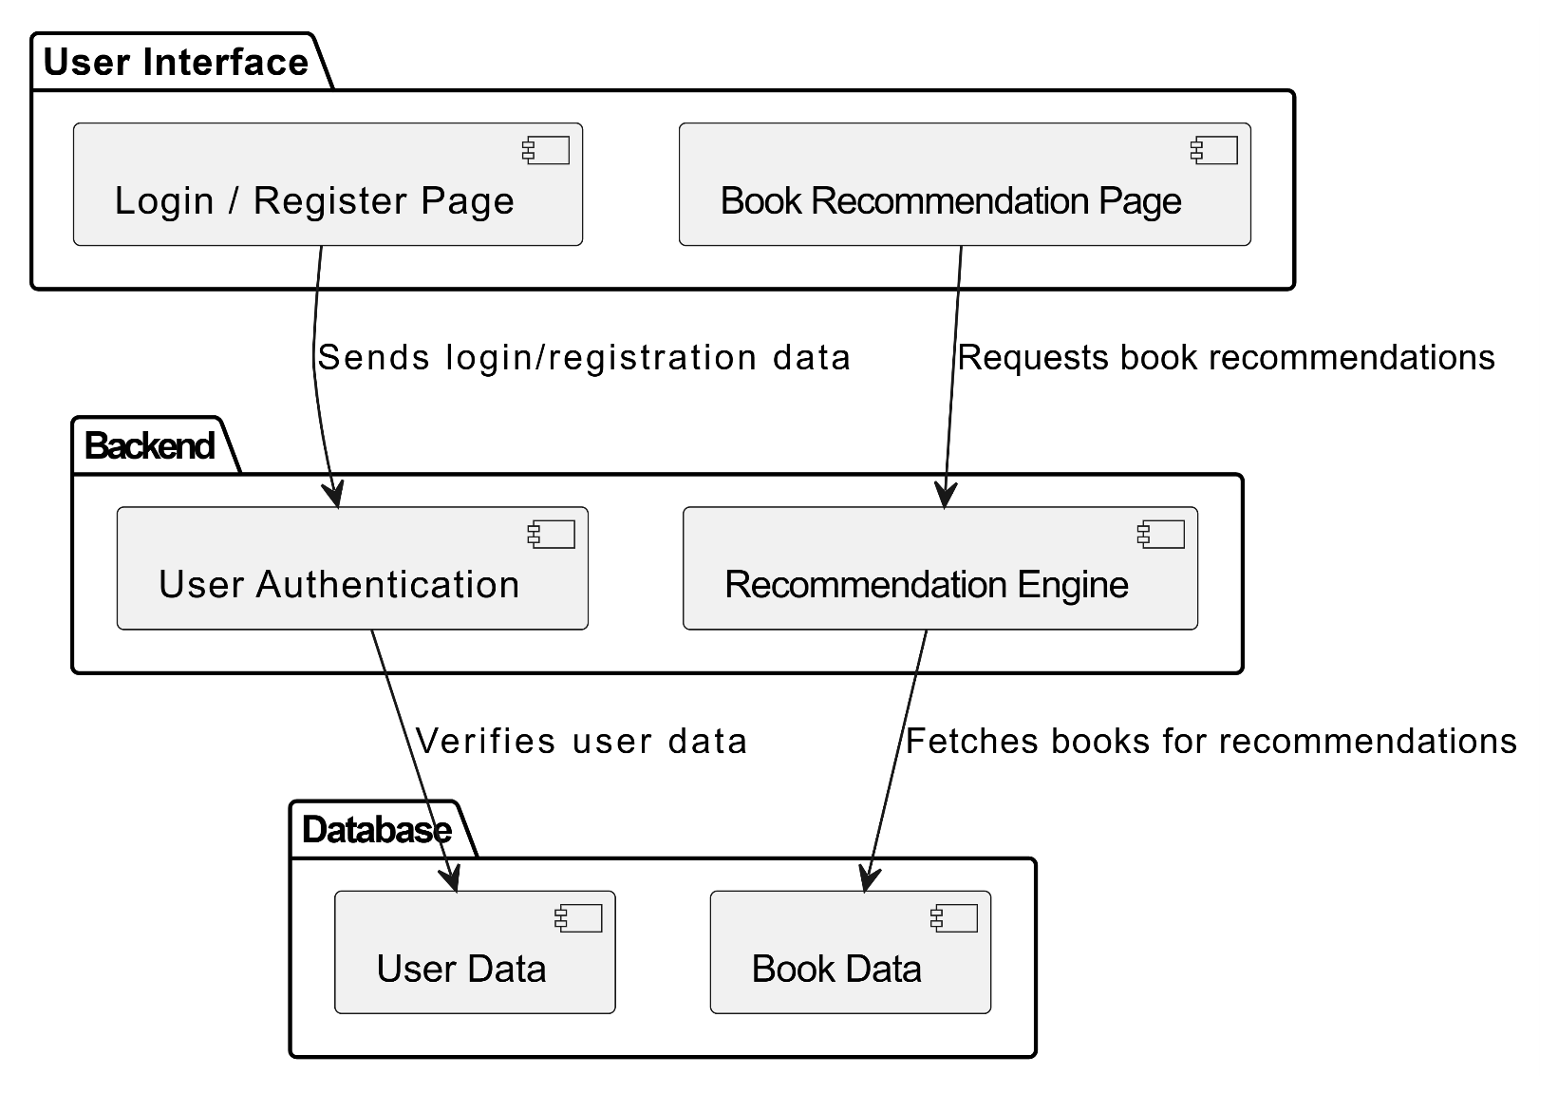
Architecture

Slide 8
Modules :
1. User Management Module:
Login/Registration: Handles user authentication, enabling users to log in, register, and manage their credentials.
Profile Management: Allows users to view and update personal details such as their name and preferences.
Session Management: Manages user sessions, ensuring users stay logged in during interactions with the app.
2. Book Recommendation Module:
Book Catalog: Displays a list of available books along with their details, such as title, genre, and length.
Search & Filter: Provides users with the ability to search for books based on specific criteria like genre and narrative style.
Book Recommendation Engine: Recommends books based on user preferences, such as genre, narrative, and preferred reading time.

Slide 9
Modules :
3. Admin Management Module:
User Management: Allows the admin to manage users, including registration, login status, and other user details.
Book Management: Admin can add, update, or remove books from the catalog, keeping the recommendations fresh.
Reporting: Provides insights into user activity, book recommendations, and other statistics for monitoring system performance.

Slide 10
Unit Testing :
Unit testing is the process where you test the smallest functional unit of code. Software testing helps ensure code quality, and it's an integral part of software development. It's a software development best practice to write software as small, functional units then write a unit test for each code unit.

Slide 11
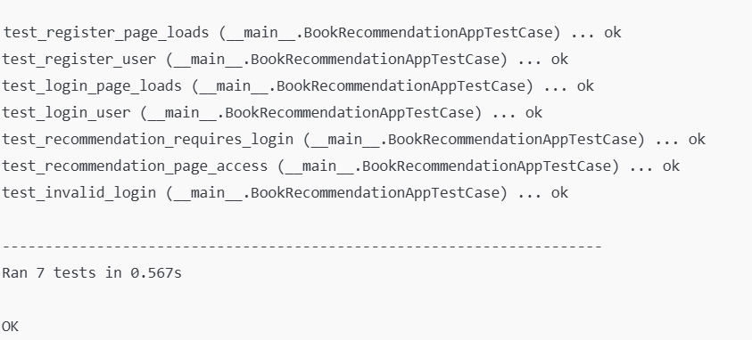
Unit Testing:

Slide 12
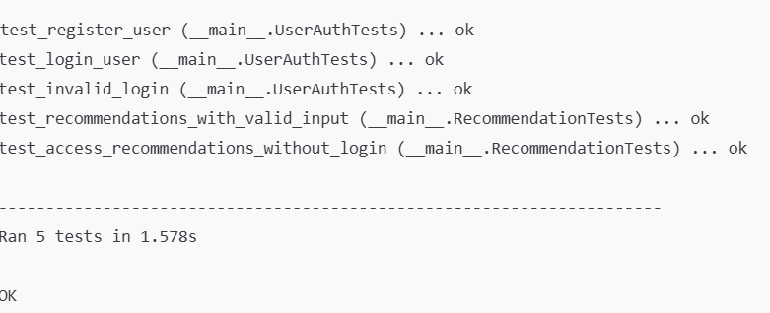
Unit Testing:

Slide 13
Integration Testing :
Integration testing is a type of software testing that verifies that the components of an application work together as expected. It's a broader test than unit testing, which focuses on isolated components of an application.

Slide 14
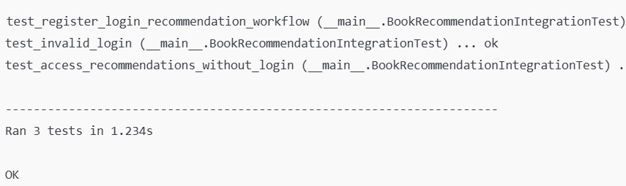
Integration Testing:

Slide 15
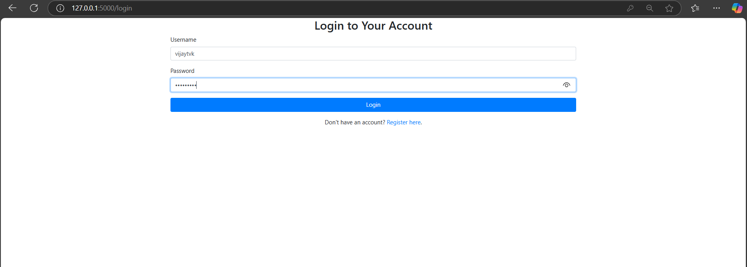
Login Page:

Slide 16
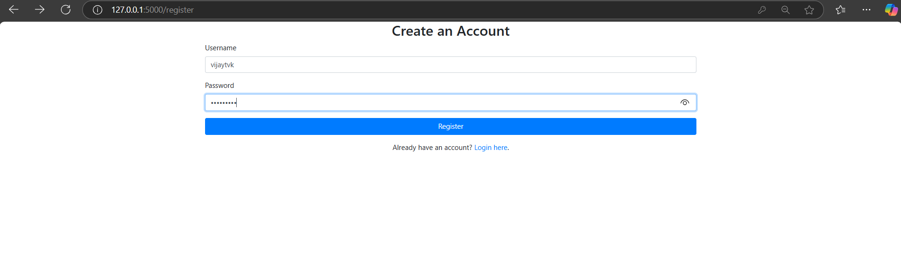
Register Form:

Slide 17
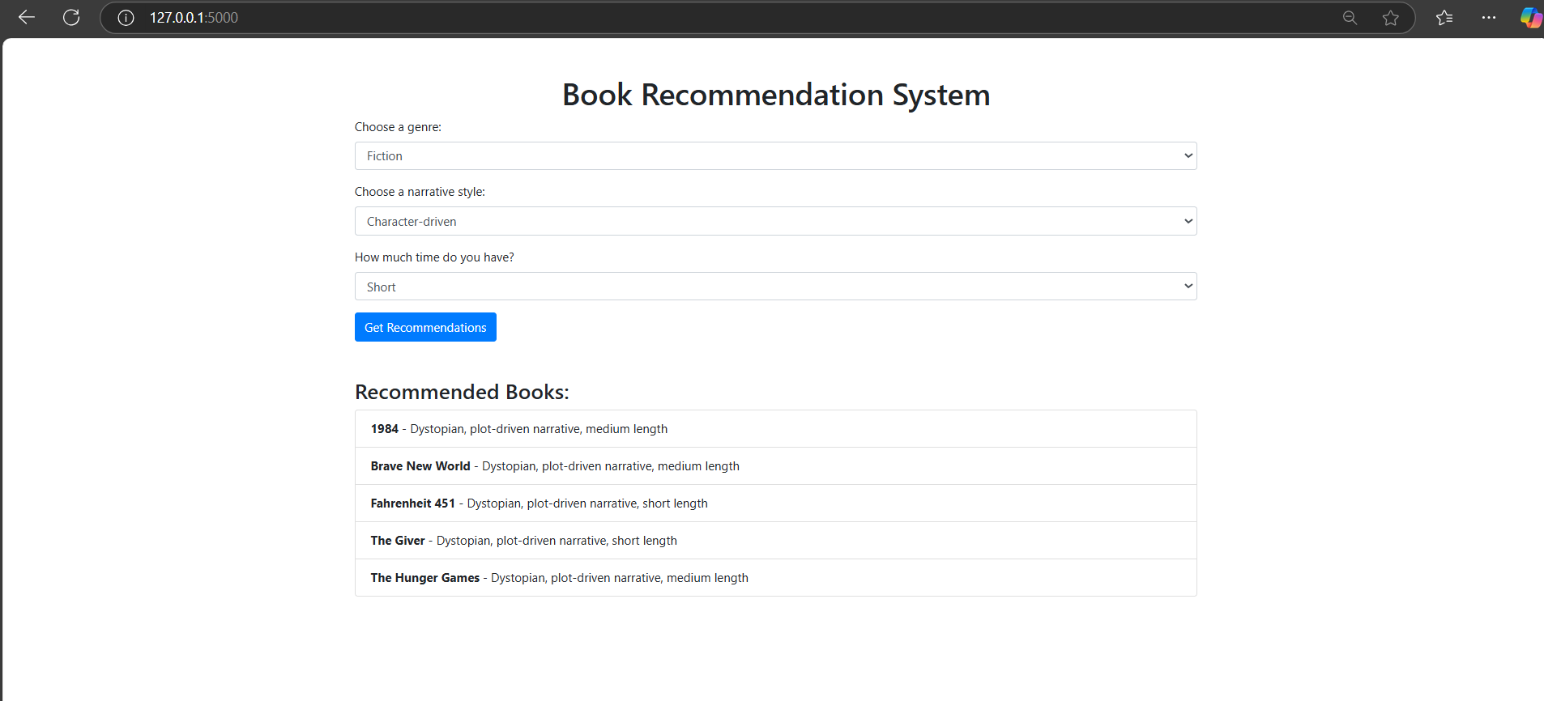
Output:

Slide 18
Data Flow Diagram
Level 0 DFD:
Register/Login
Filtering
USER
Recommendation Engine
ADMIN
Search Books
Level 1 DFD:
User
Recommendation
system
Login/Registration
View Library
Hybrid Filtering
User Database
Books Database
Catergories

Slide 19
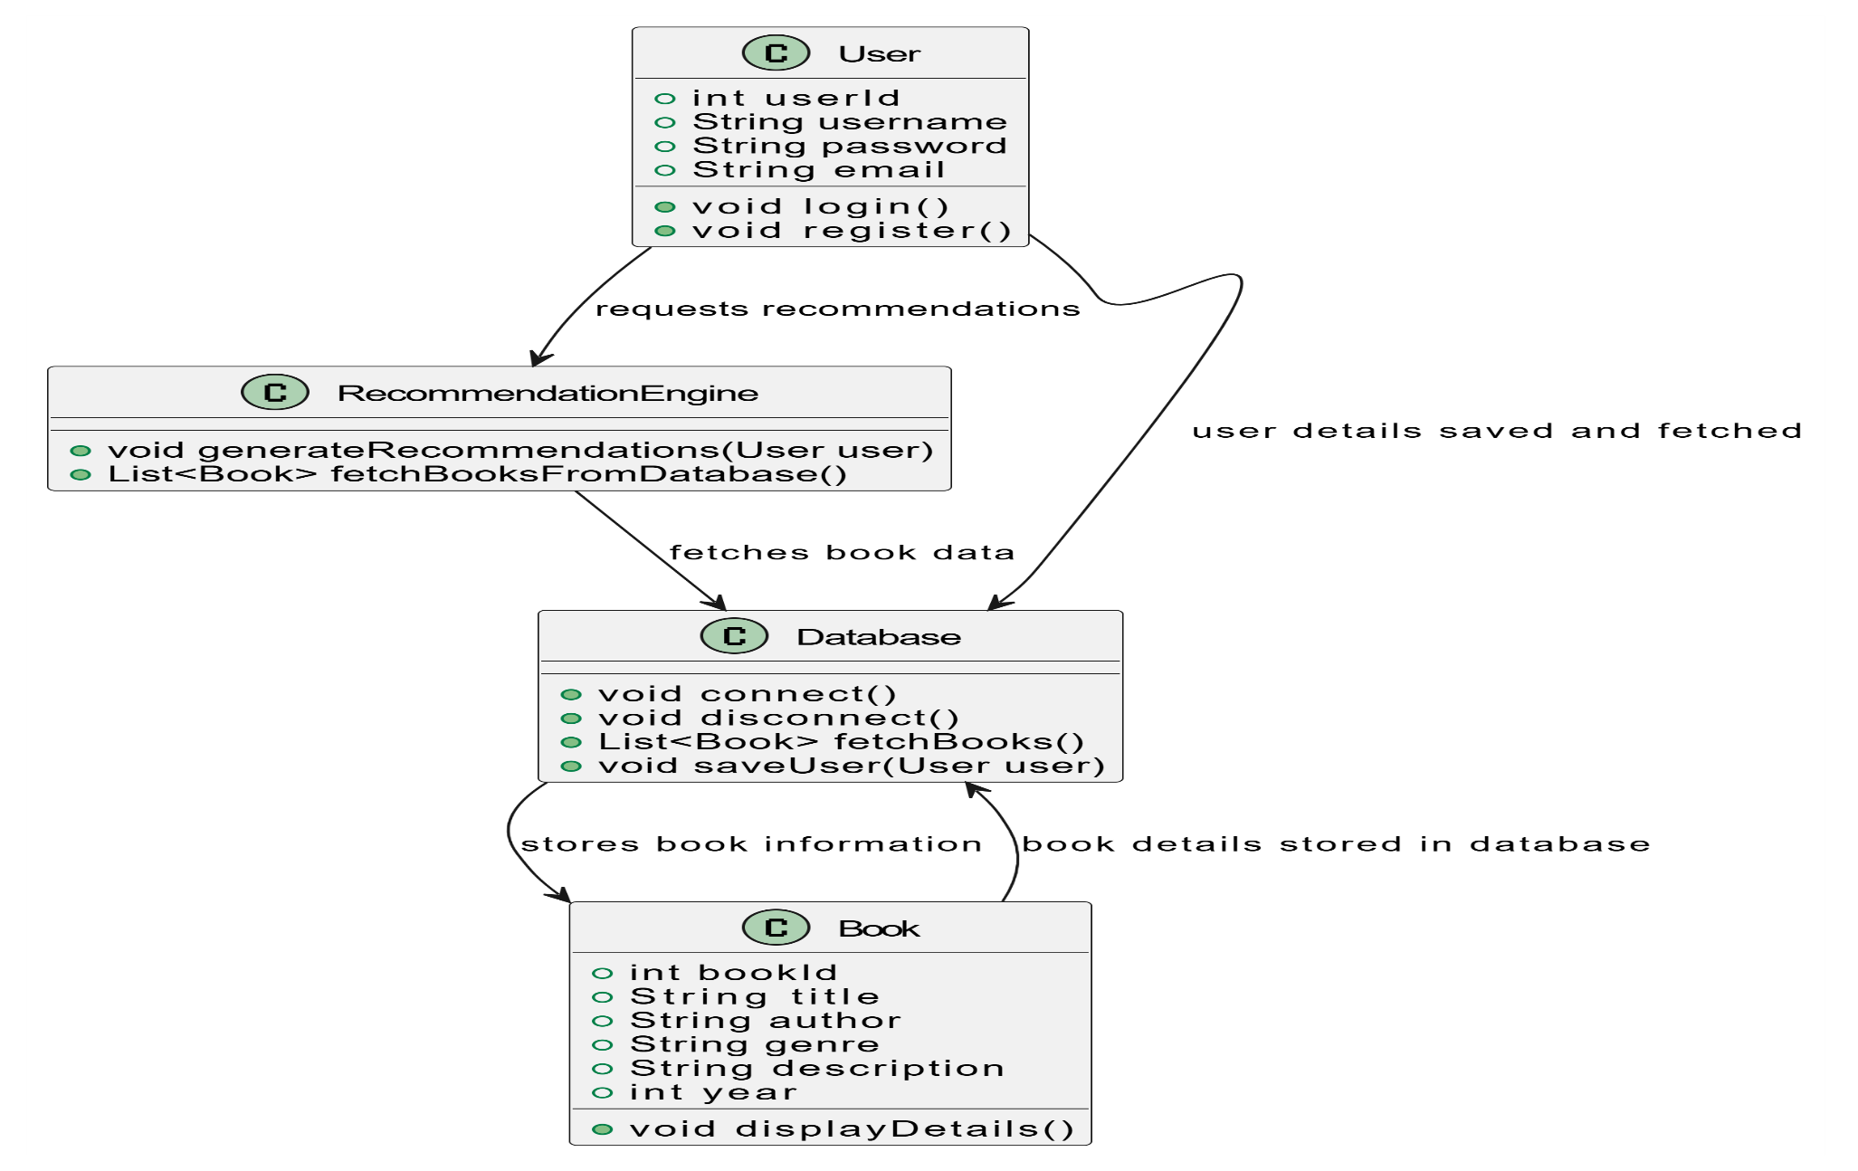
Object Oriented Design

Slide 20
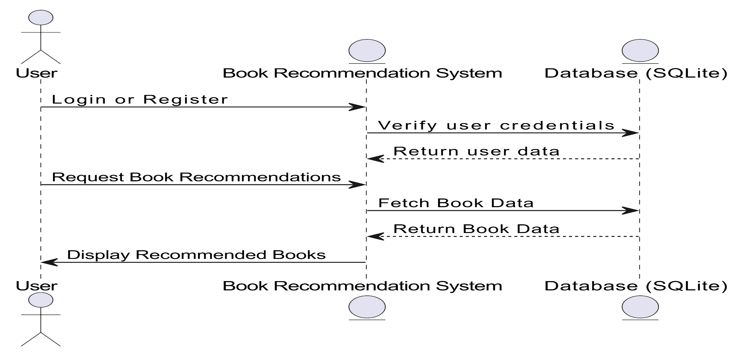
Sequence Diagram

Slide 21
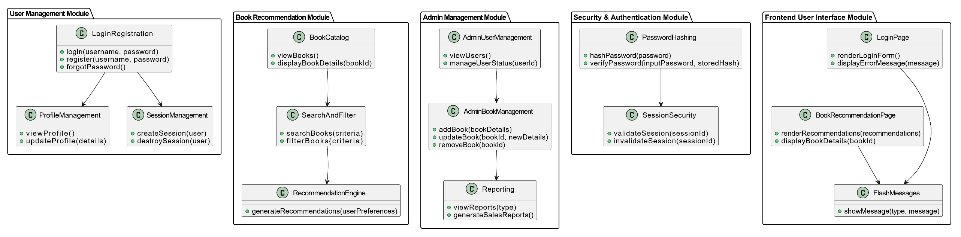
UML Diagram

Slide 22
Conclusion
The Book Recommendation System is designed with modular components to ensure scalability, security, and user-friendly interactions. The User Management module handles authentication and profile management, while the Book Recommendation module filters books based on user preferences. The Admin Management module allows for efficient monitoring of users and books. The system also incorporates secure Authentication to protect user data and a smooth Frontend UI for easy navigation. This modular design allows for future scalability, such as adding new features like ratings or reviews, and ensures smooth collaboration among developers, enhancing productivity and system flexibility.

Slide 23
References
Flask Official Documentation: https://flask.palletsprojects.com/
Werkzeug Documentation: https://werkzeug.palletsprojects.com/
Jinja2 Documentation: https://jinja.palletsprojects.com/
SQLite Documentation: https://www.sqlite.org/docs.html
"Flask Web Development" by Miguel Grinberg: https://www.amazon.com/Flask-Web-Development-Development-Deployments/dp/1449372627
"Python and Flask Bootcamp: Create Websites with Flask!" by Jose Portilla (Udemy): https://www.udemy.com/course/python-and-flask-bootcamp-create-websites-with-flask/
"Python Data Science Handbook" by Jake VanderPlas: https://www.oreilly.com/library/view/python-data-science/9781491912126/

Slide 24
Thank You

